Slide 1
Rapid Feedback Event
By The 4 Codesmen - Abraham, Dhruv, Dinesh, Favor
ENSE 400/477(2022-2023): SSE Capstone

Slide 2
Project Intro
For our capstone project we are building a web application for U of R residence
We are building a digital platform that allows U of R Residence students to:
connecting student and make friends
help each other out academically, and be part of residence life
updated about events and participate in these events.
provide faculty-based resources/residence-based resources [Where the faculty is located/number/emails and residence contacts/emails/locations].
provides students with food recipes and food locations close to the U of R Residence.
This application can decrease that social gap and give a digital platform for students to broaden their network at U of R.

Slide 3
Project Progress
Completed tasks
Login/Registration page
Chat Feature
Food-Feature
Take-out
Recipes

Slide 4
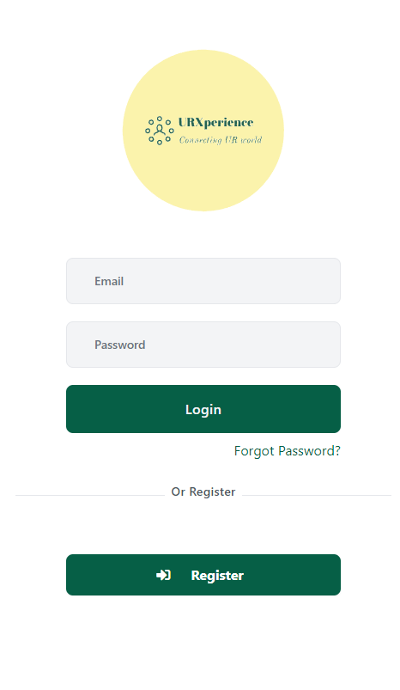
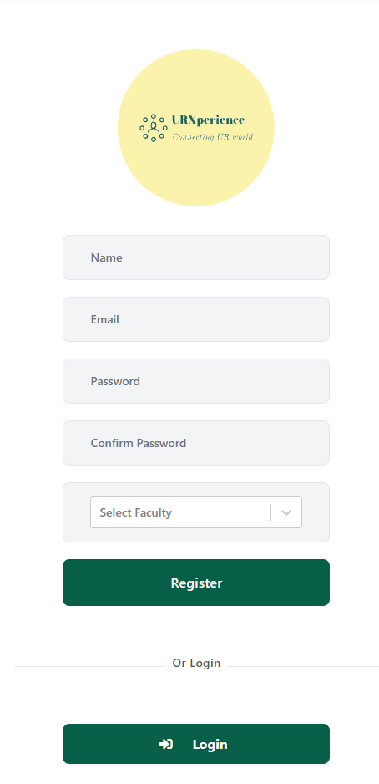
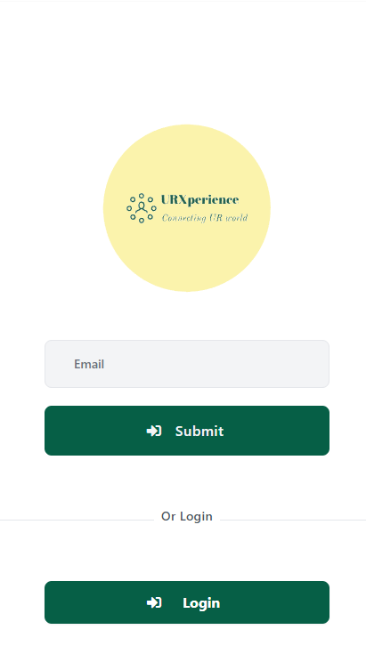

Slide 5
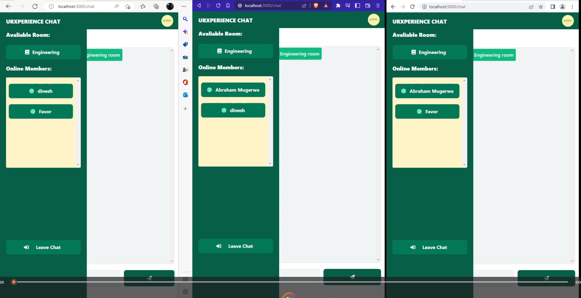

Slide 6
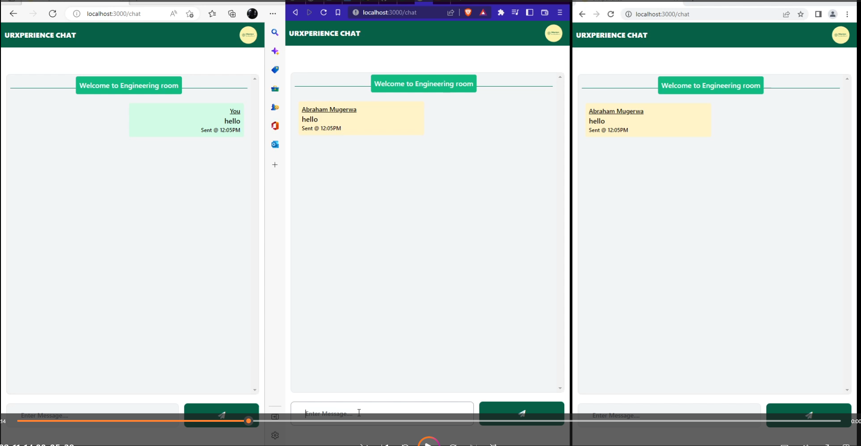

Slide 7
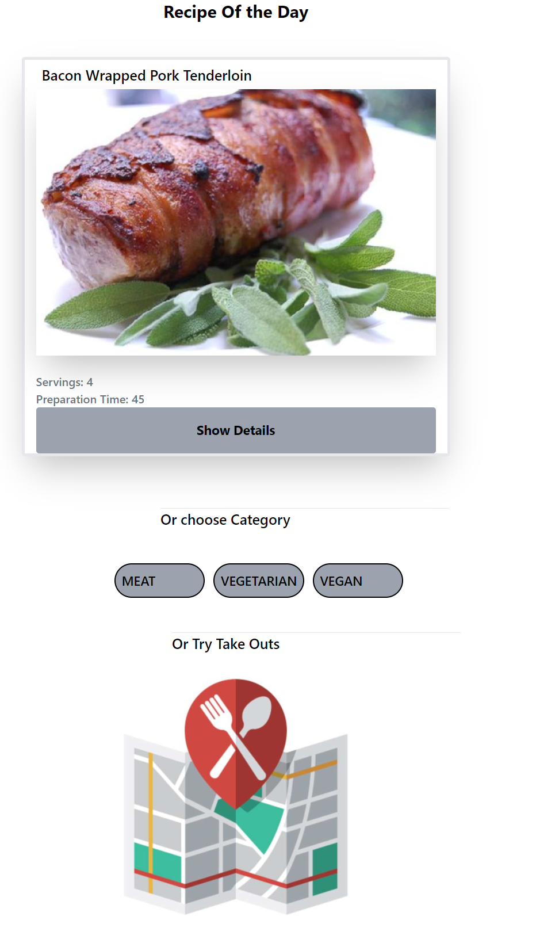
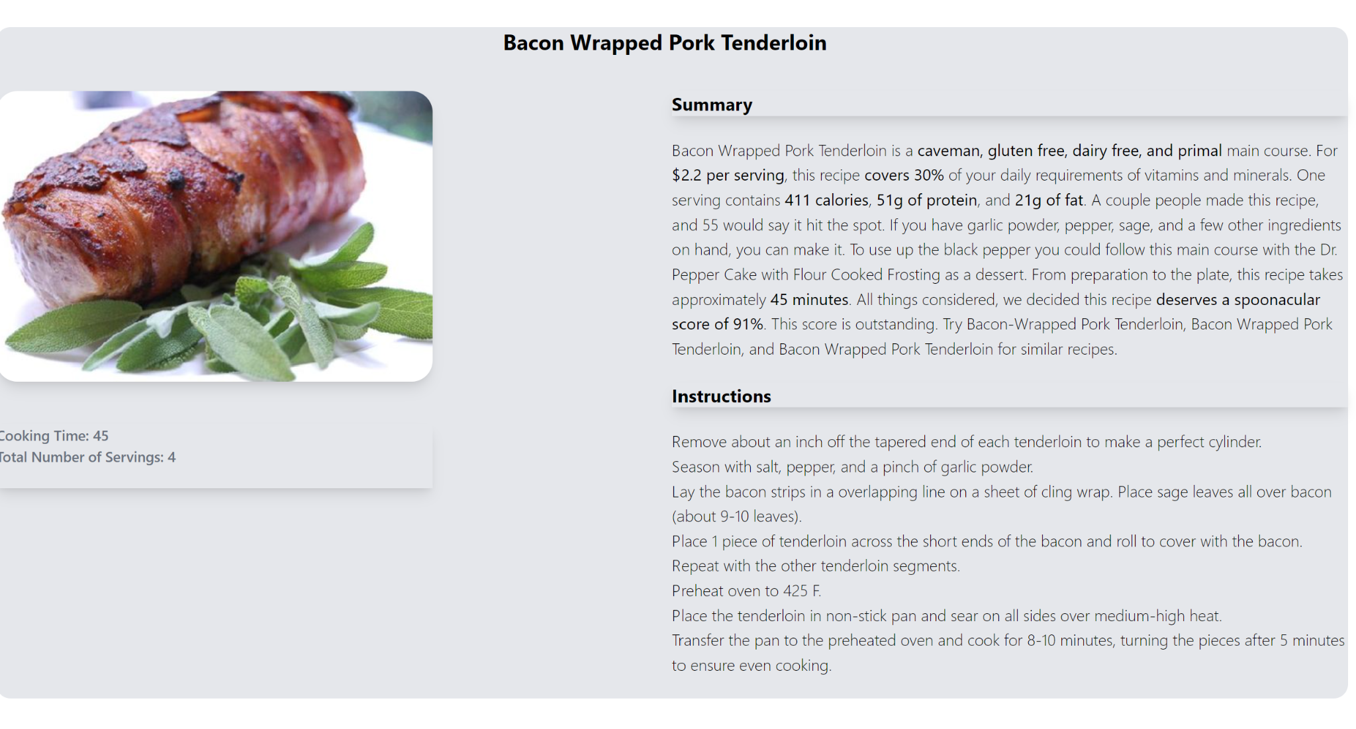
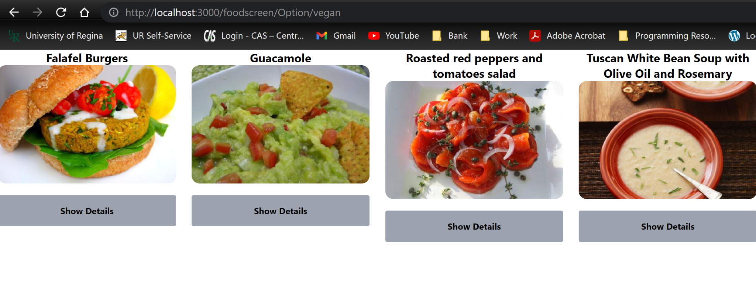
Recipe Page
Recipe Of The Day
Recipe Details Page
Vegan Recipes

Slide 8

Food Take Outs Feature

Slide 9
Feature in need of Feedback
Food-Feature
Take Out Feature:
We will populate the rating system for the restaurants and image of each rendered food location
Add Pinpoints of food location on the Map
We plan to improve the UI (css styling)
We also plan to make sure a user can delete their account for security measures
What feedback do you have?

Slide 10
Thank you!

